Slide 1
Last presentation in UCSI
TEAM 2

Slide 2
content
1. Team introduction
2. Management
3. Front-end
4. Back-end
5. AI
6. Conclusion

Slide 3
1. Team introduction

Slide 4

Seongji Lee / Leader
Seonhye Lee / Web : Back-end
Chaeeun Jang / AI : Data-analysis
SeungHoon Lee / Web : Front-end
Paranhaneul Kim/ AI : modeling
Yeran Heo / Web : Front-end

Slide 5
2. Management

Slide 6

Our Team Philosophy
1. Open Communication
2. Pragmatism
3. Completion over Perfection
4. Let’s do it with confidence

Slide 7
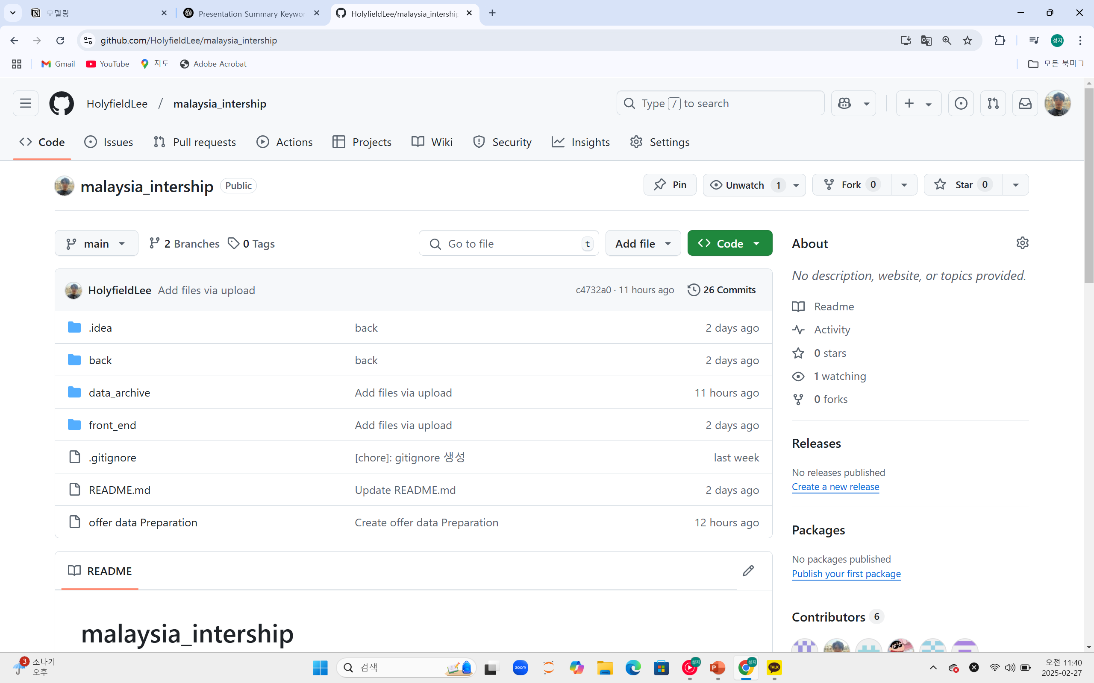
SET GITHUB

Slide 8
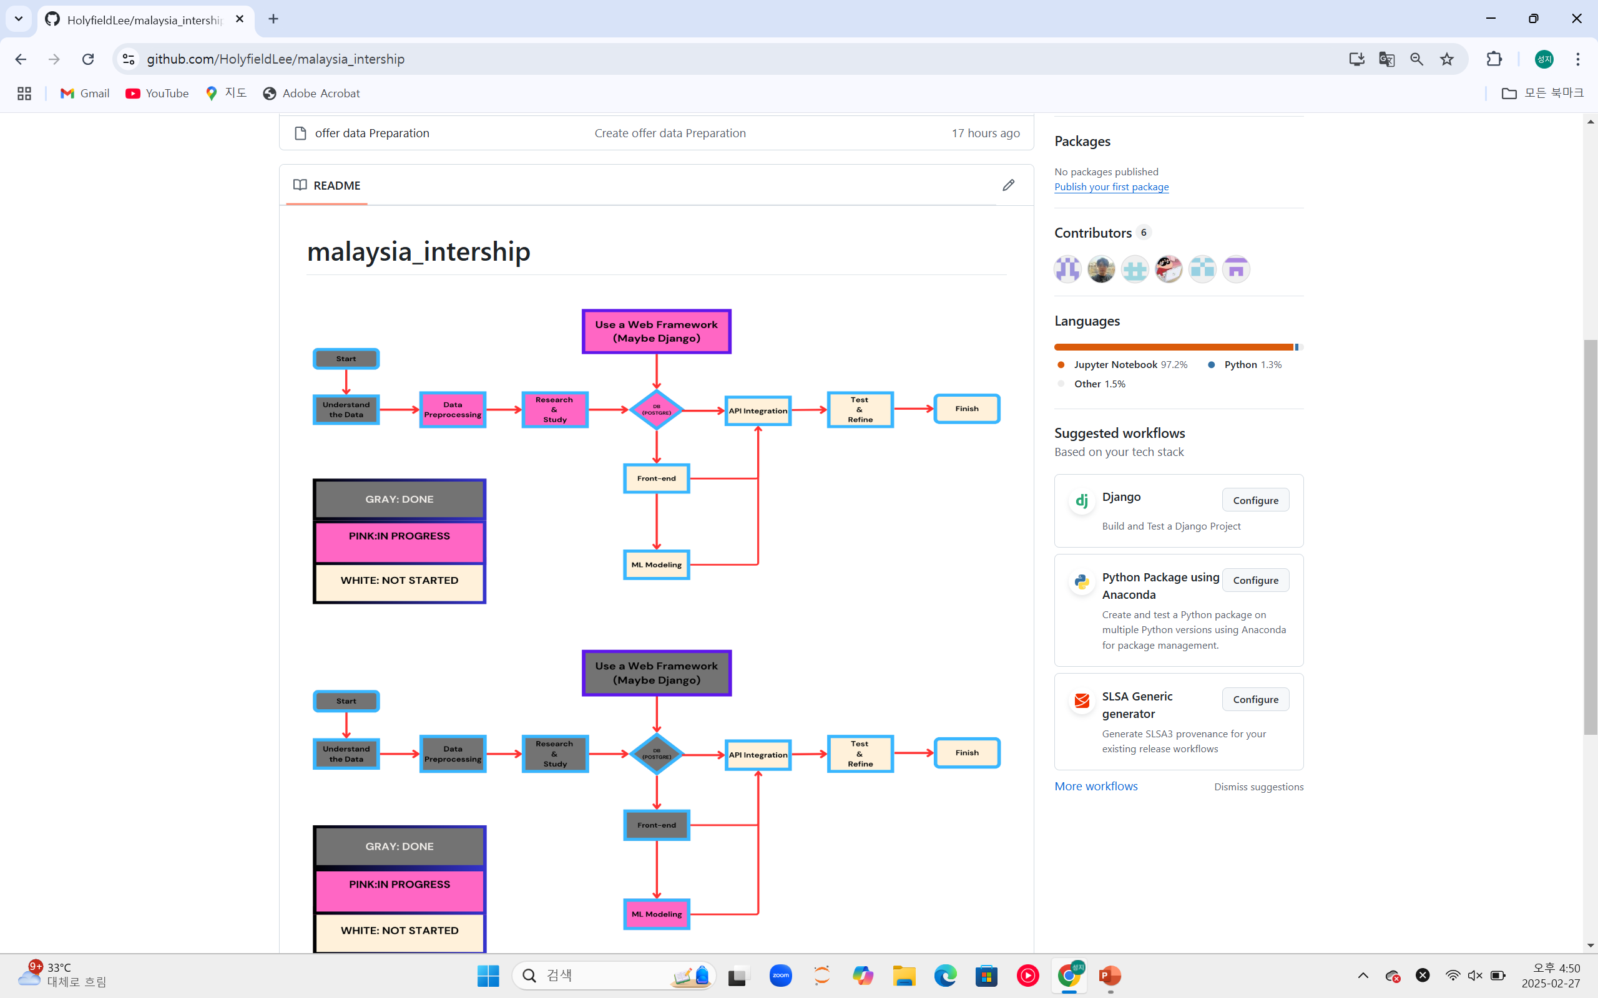
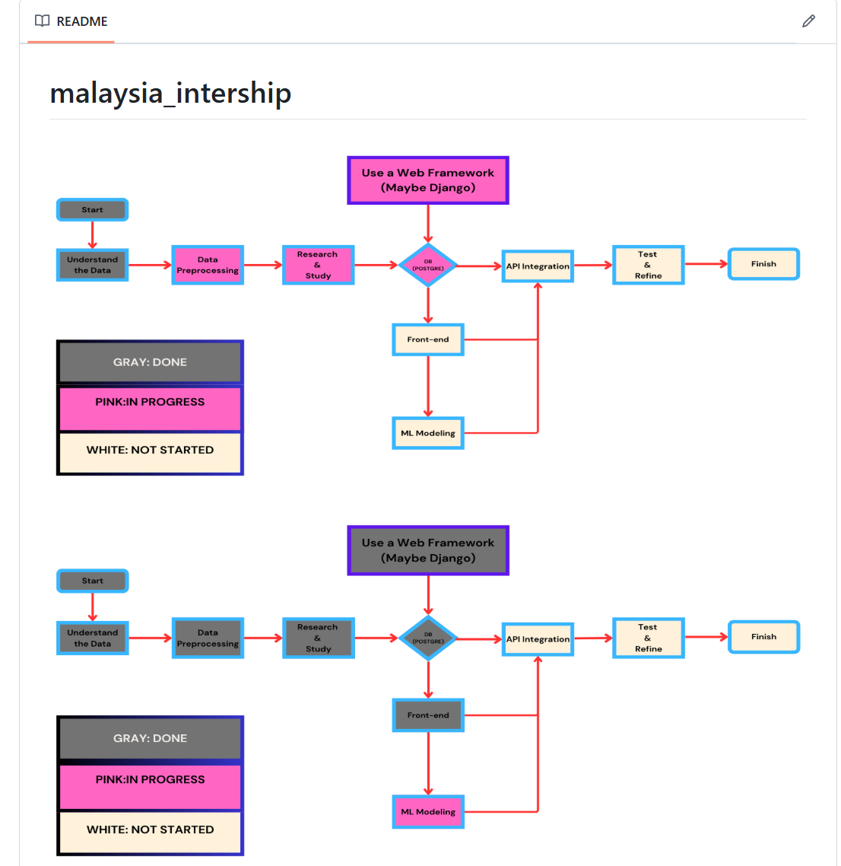
SET GITHUB

Slide 9



TOOLS

Slide 10



Front
Back
AI
Decision & Part support

Slide 11
3. Front-end

Slide 12
Learning HTML/CSS/JS
Starting coding Using React
Create a shape according to the data

Slide 13
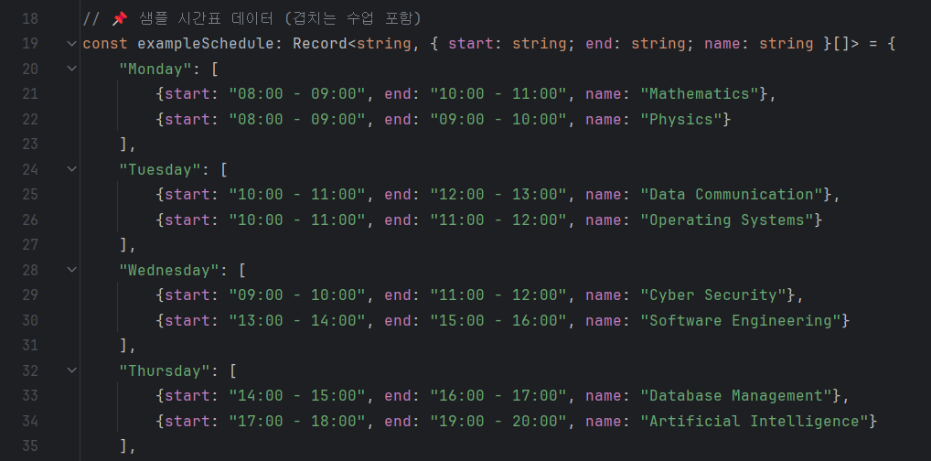

Slide 14


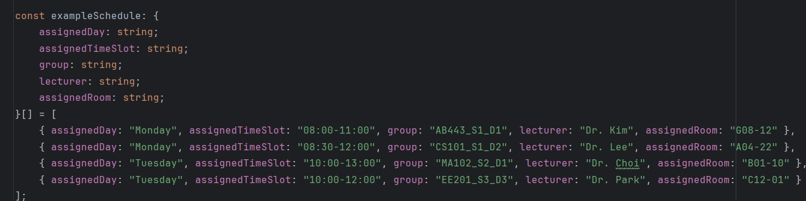

Slide 15
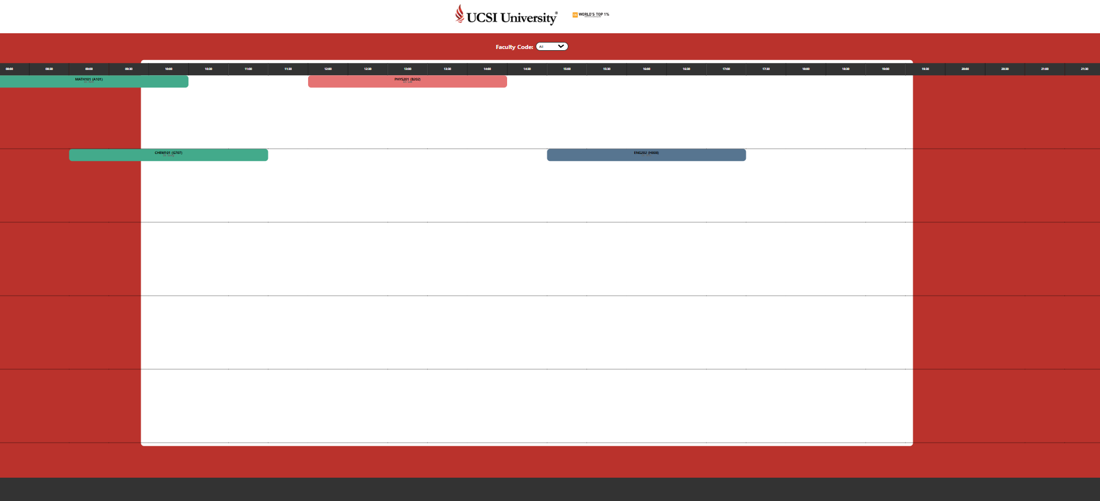

Slide 16
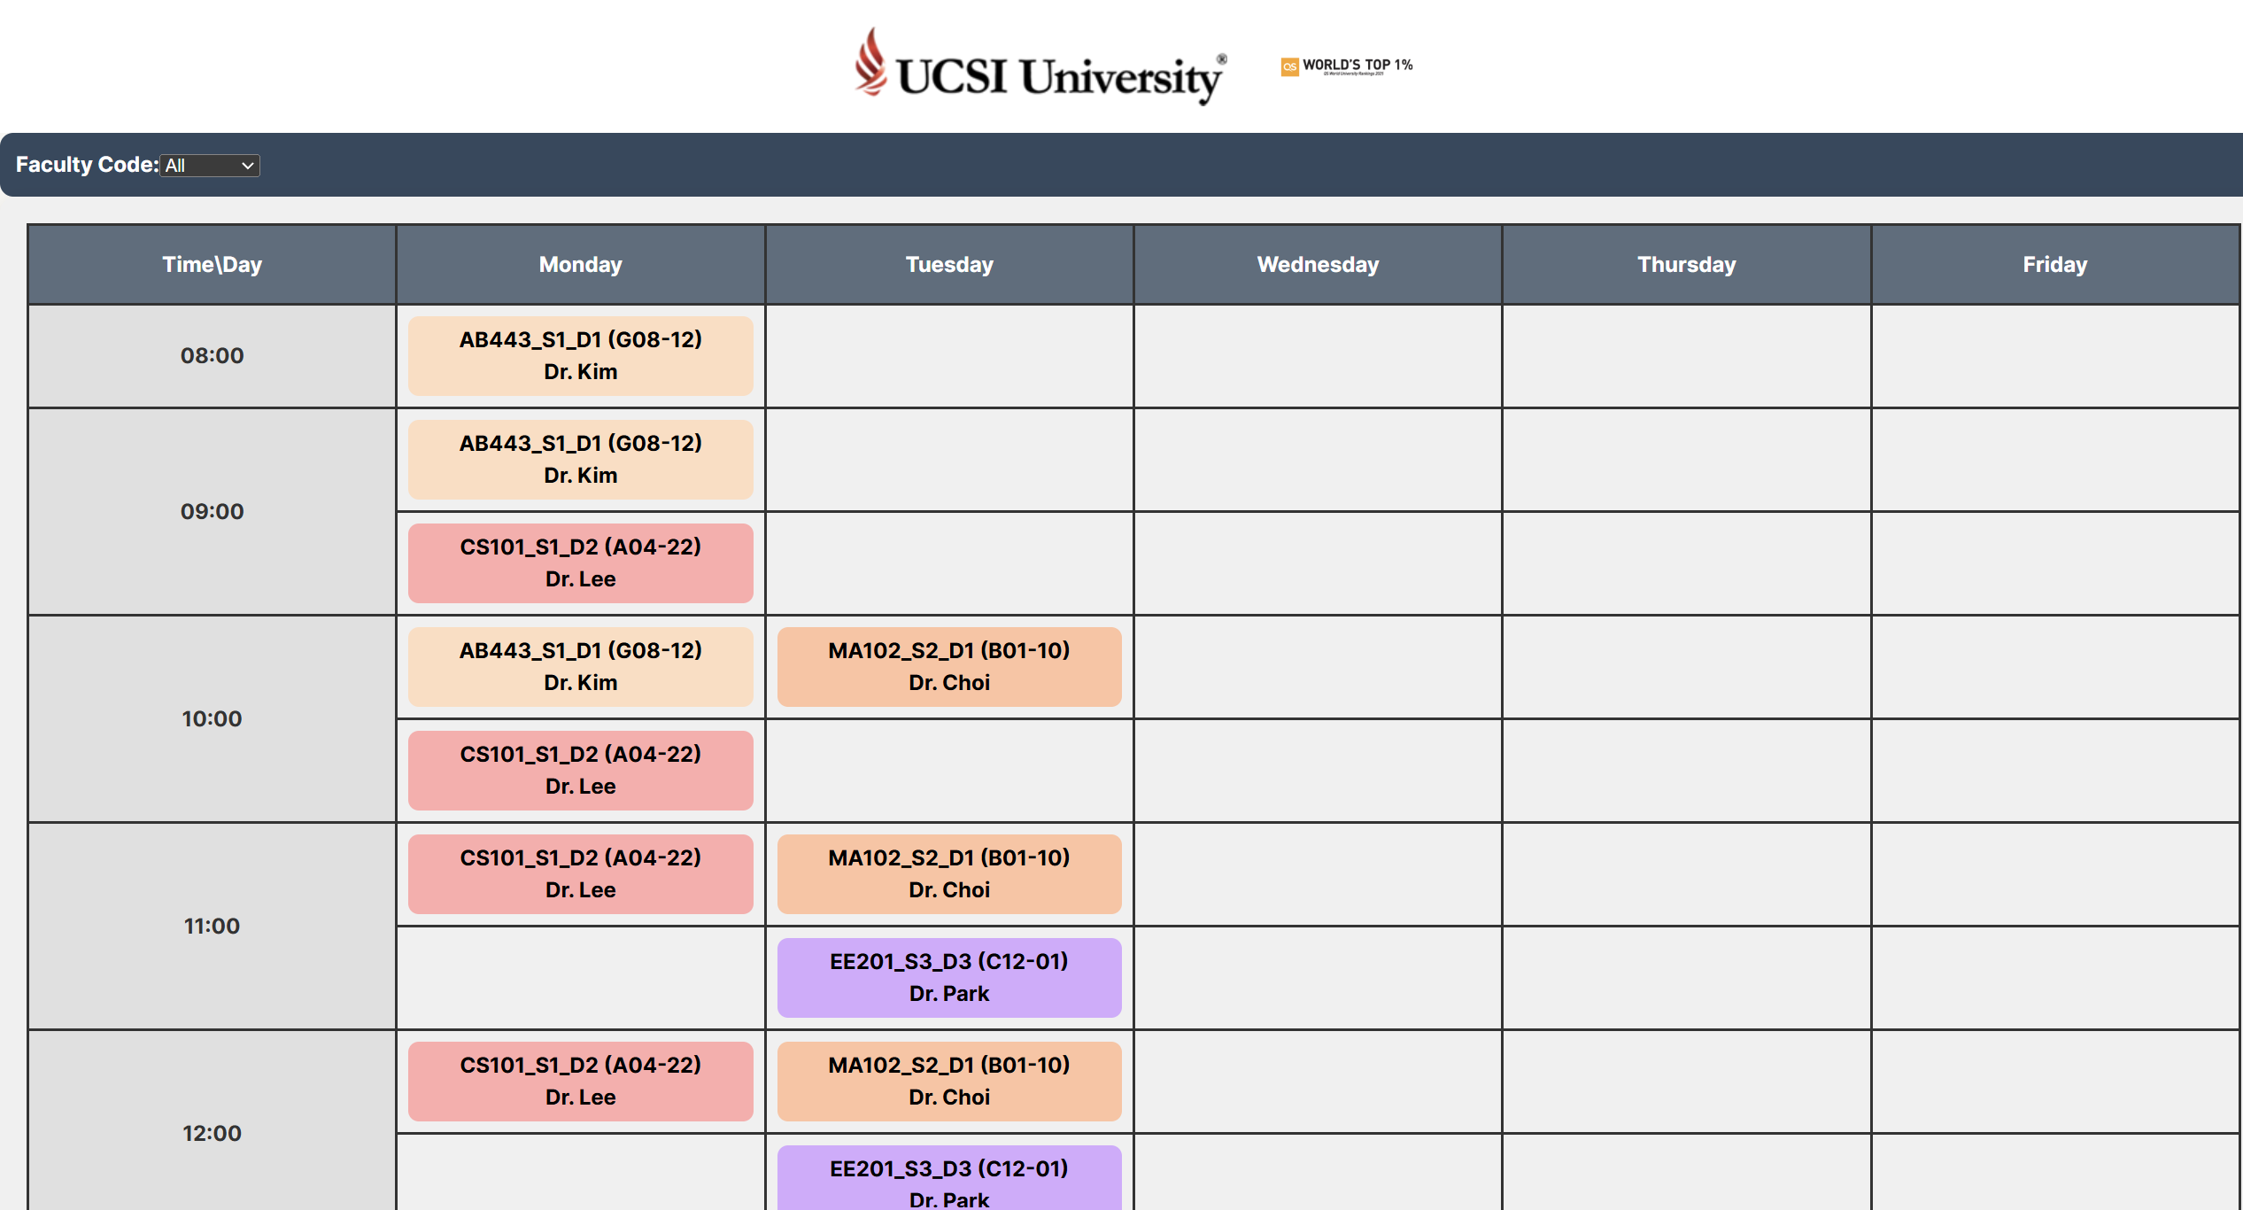

Slide 17
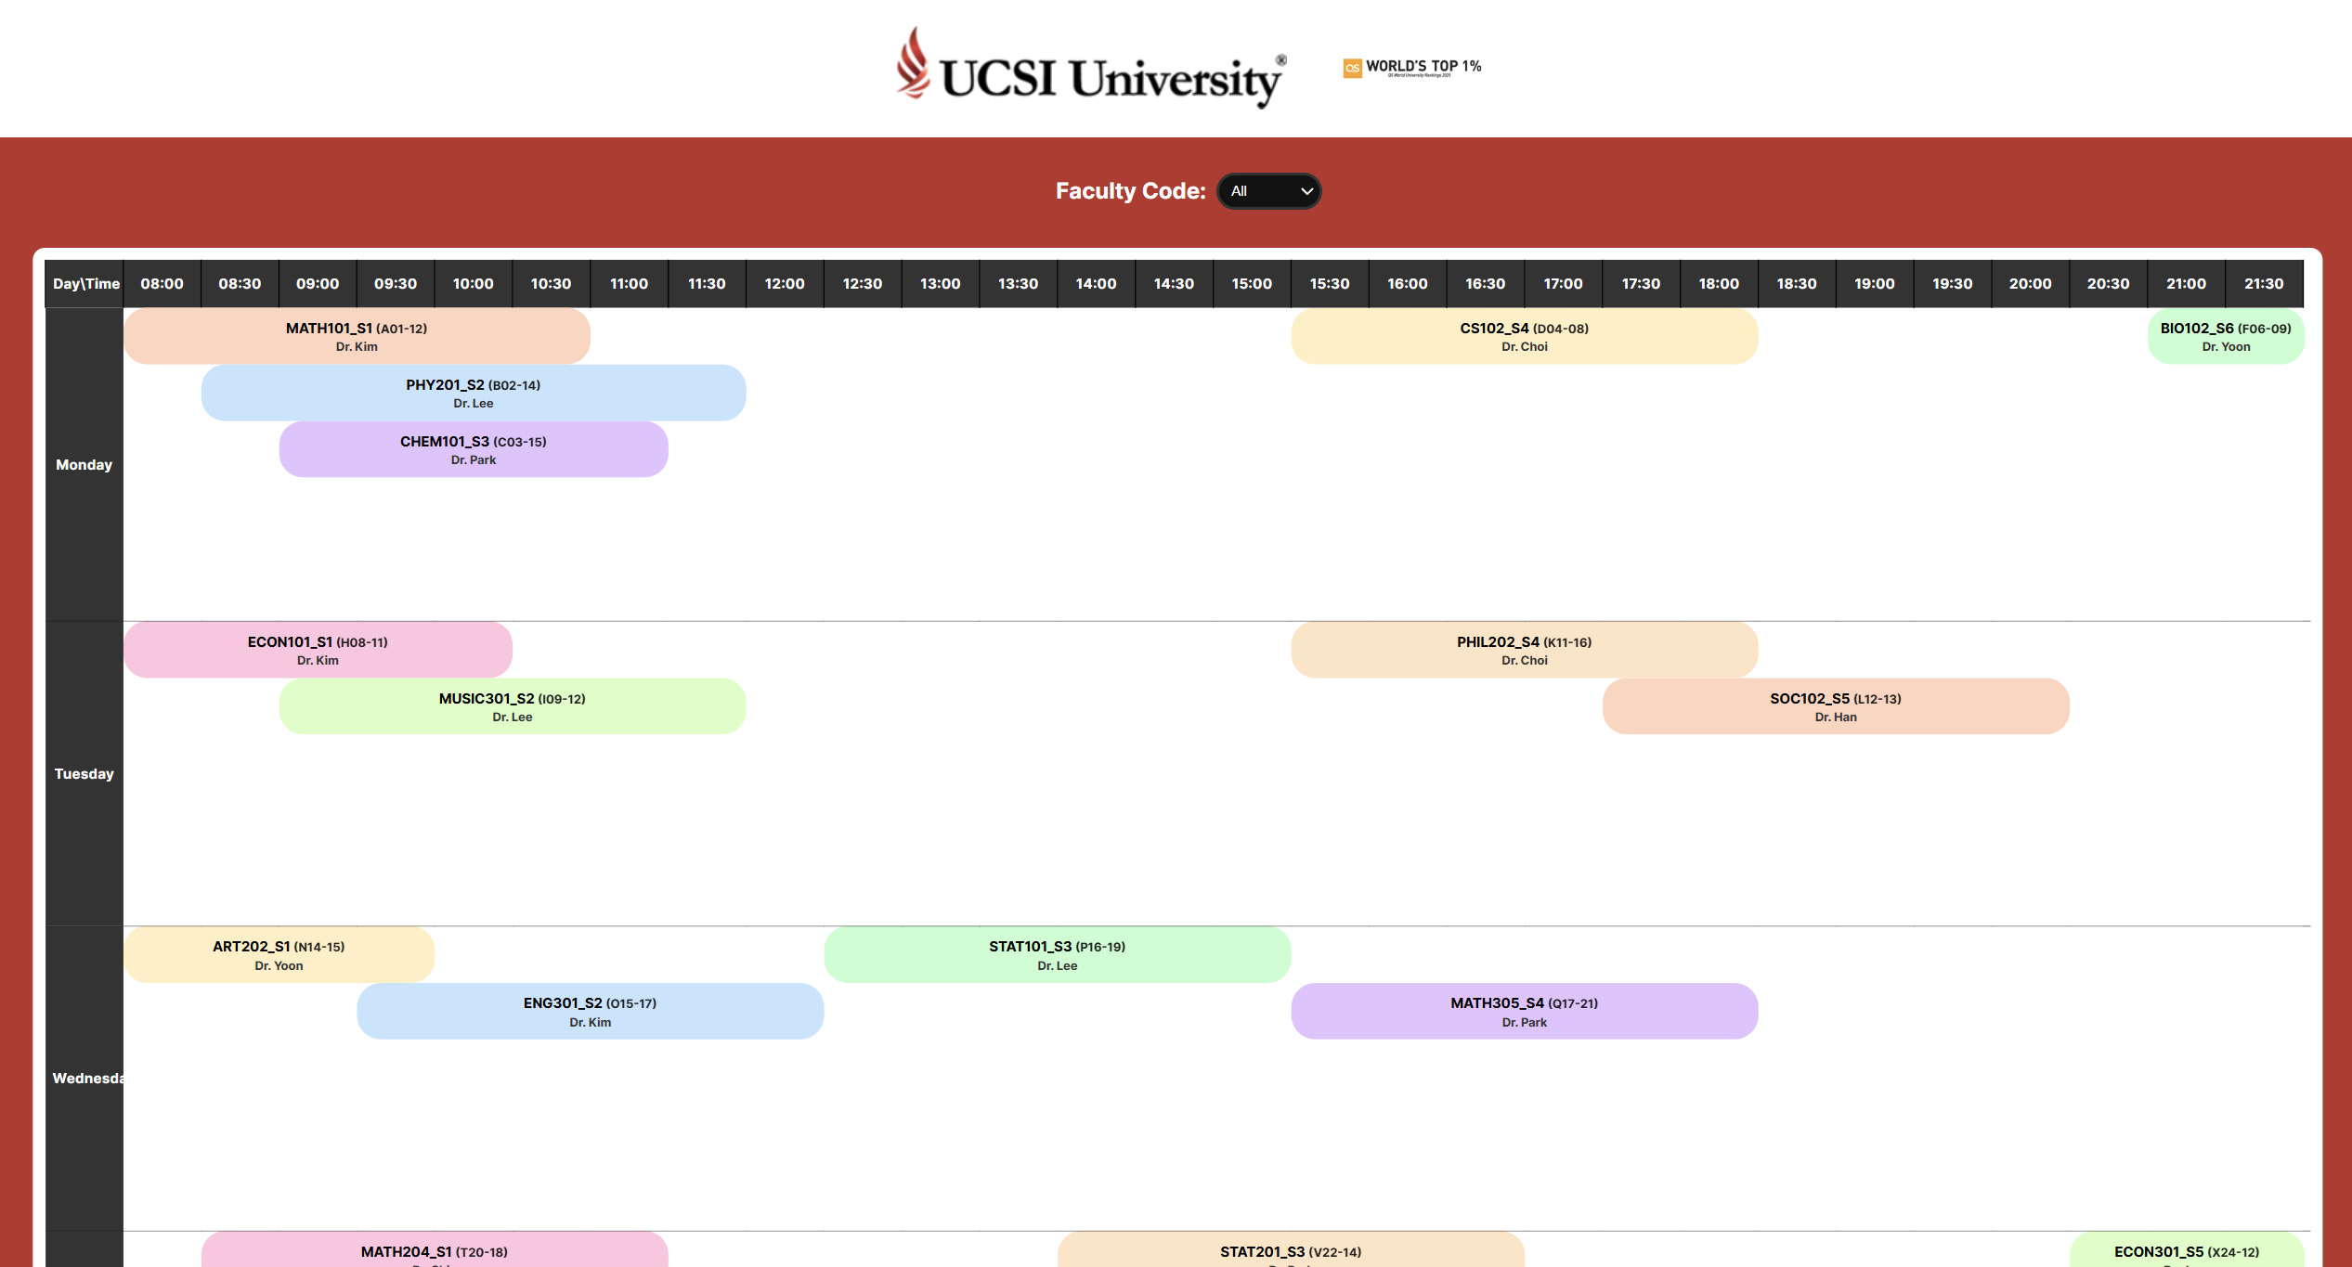

Slide 18
4. Back-end

Slide 19
Backend - Key Features
Backend
1.
Initial environment setting
-Django Setup
2.
Imports classroom and course information from Excel files, processes the data
3.
automatically
assigns classes
to appropriate classrooms based on predefined algorithms
4. Connecting the API

Slide 20
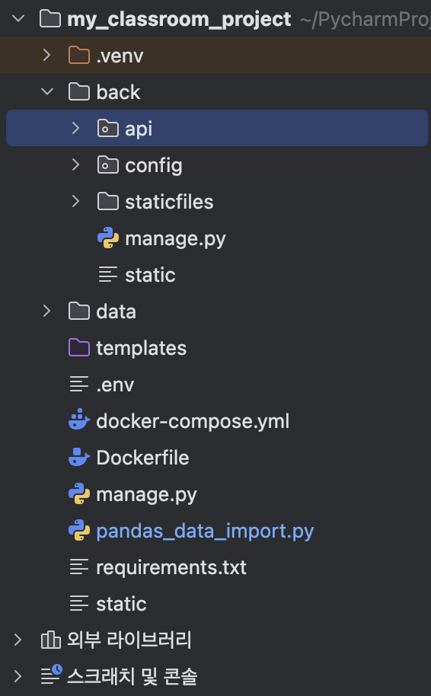
Project File Structure
• my_classroom_project/:
• .venv/ : Virtual environment
• back/ : Backend-related code
• api/ : API-related code (models, serializers, views, etc.)
• config/ : Django configuration files
• data/ : Data files (Excel files)
• templates/ : HTML templates (for frontend use)
• static/ : Static files (CSS, JS, etc.)
• manage.py : Django project management file
• requirements.txt : Project dependencies list
• .env : Environment variable settings

Slide 21
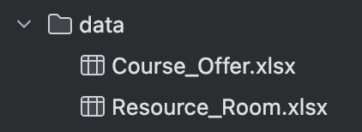
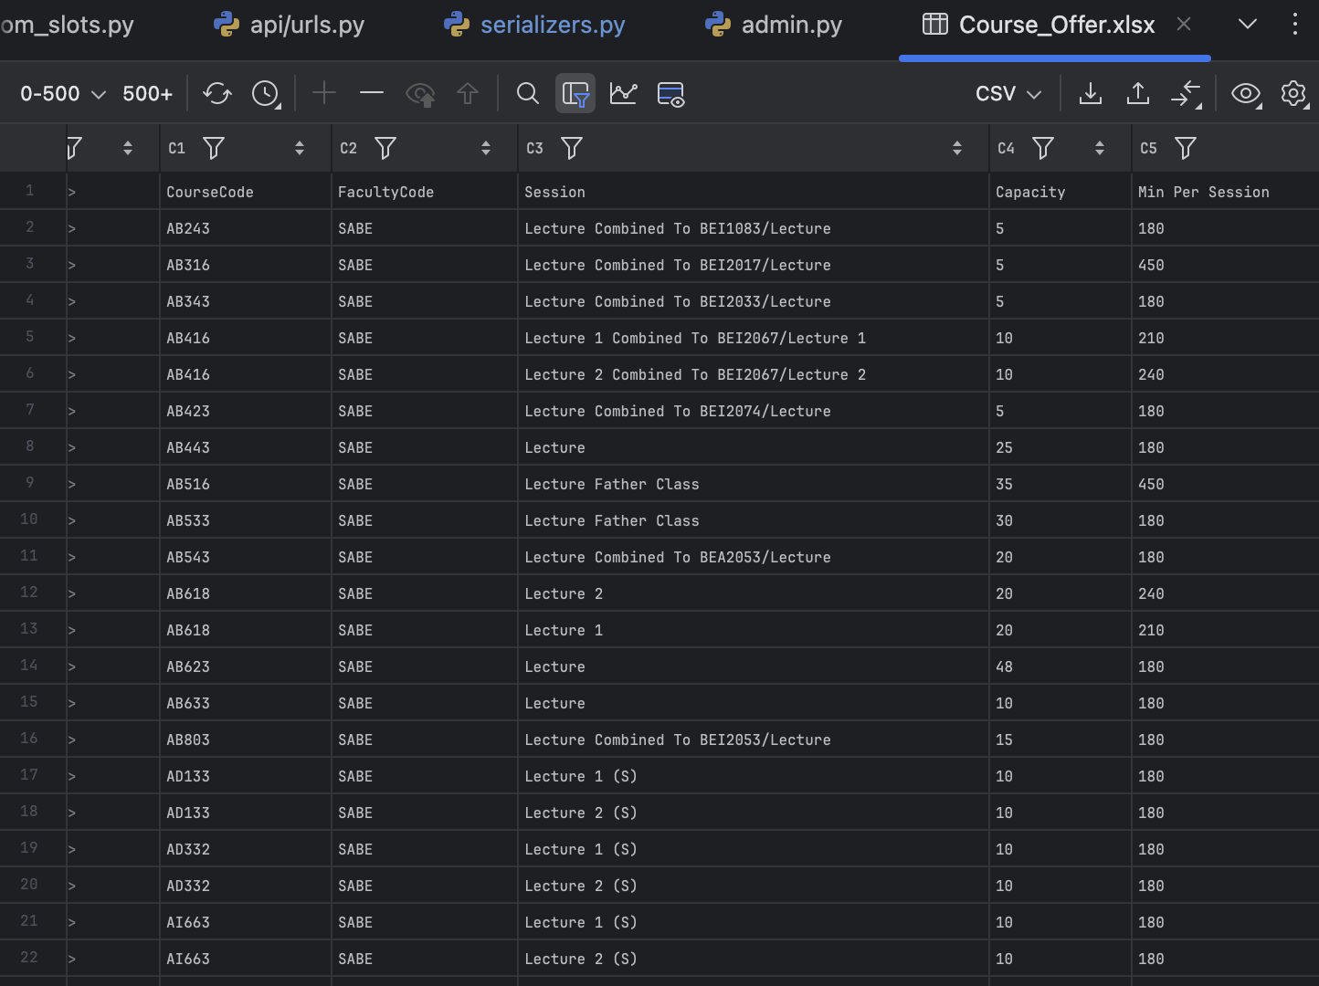
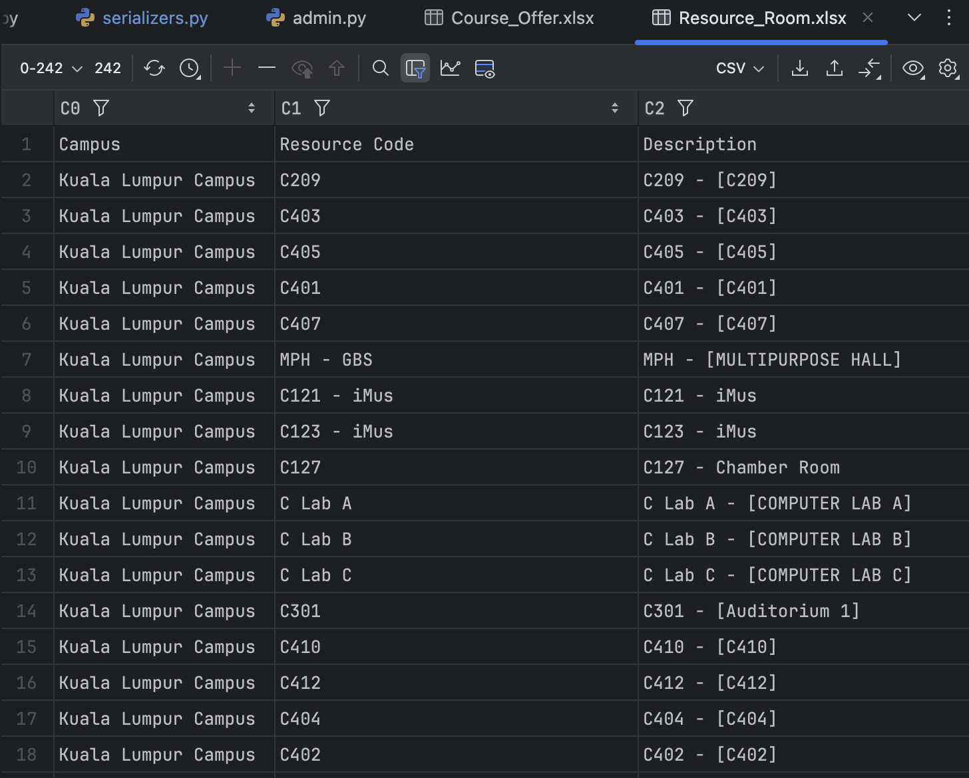
Data Processing
Data Files:
• Resource_Room.xlsx: Classroom information
• Course_Offer.xlsx: Course information

Slide 22
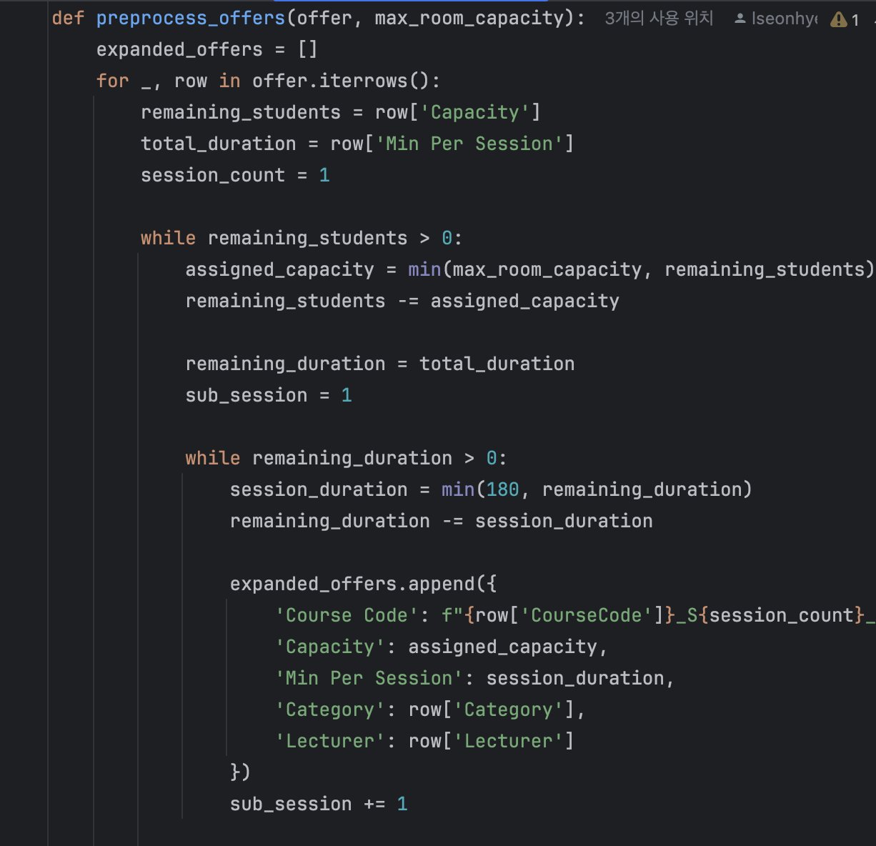
Data Processing
Data Processing Process:
• Reading Excel files: We use the pandas library to read the Excel files and convert them into DataFrames.
• Preprocessing: We extract necessary data and remove unnecessary columns.
The preprocessed data is then used as input for the algorithm that matches courses to classrooms.

Slide 23
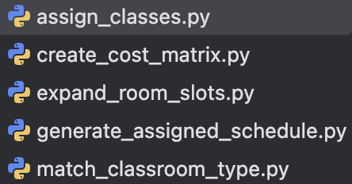
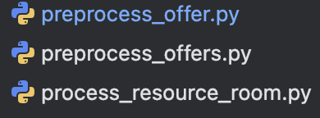
Algorithm
Separated the algorithm into individual functions and created a separate file to integrate it with the data.
Implemented logic to read and process the data.
Enabled users to view the assigned classroom schedule in the UI.
I integrated the algorithm with the data and ensured that the final schedule could be displayed in the view.

Slide 24
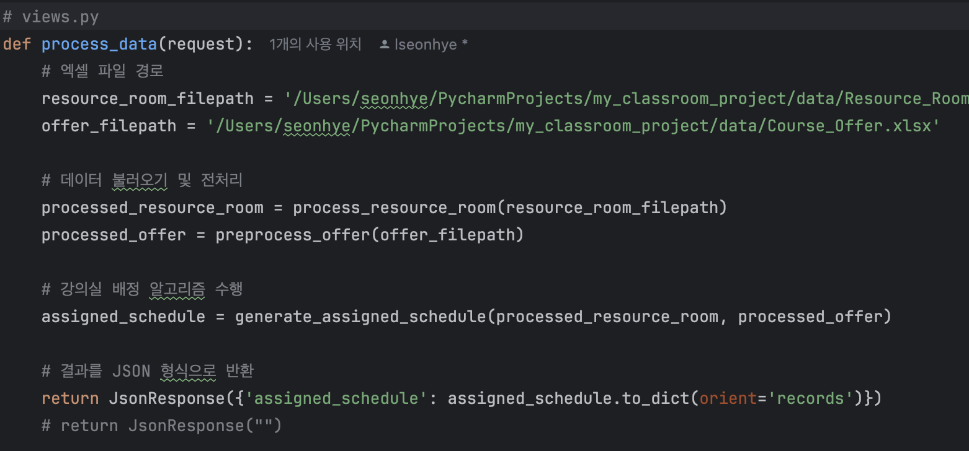
Backend Implementatio – Django Project
• views.py: Contains the API endpoints where the processed data is passed into the algorithm and the result is returned as a JSON response.
Backend Implementatio – Algorithm Integration
This result is then sent back to the client via a JSON response, making it accessible for frontend consumption.

Slide 25
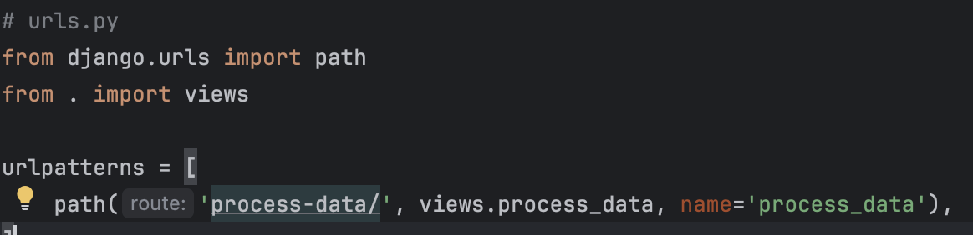
Backend Implementatio – Django Project
• urls.py: Links the URL paths to the views. For example, /assign_rooms/ will trigger the API to return the assigned classroom schedule.
Backend Implementatio – Algorithm Integration
the preprocessed data is passed to the algorithm to generate the classroom assignment.

Slide 26
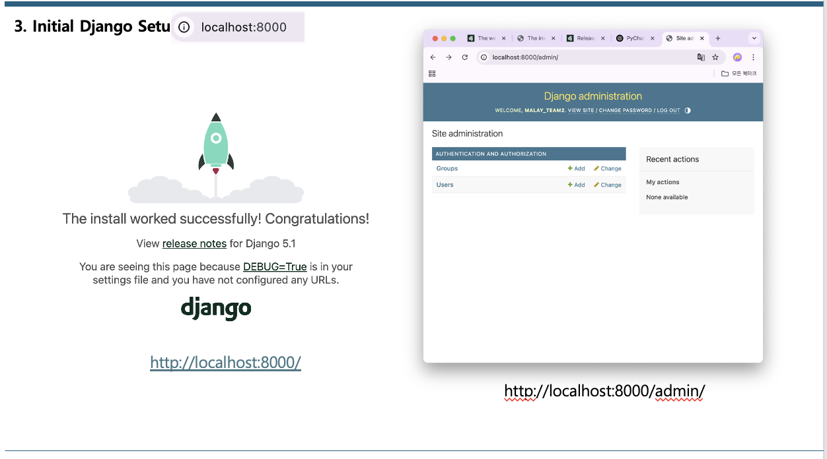
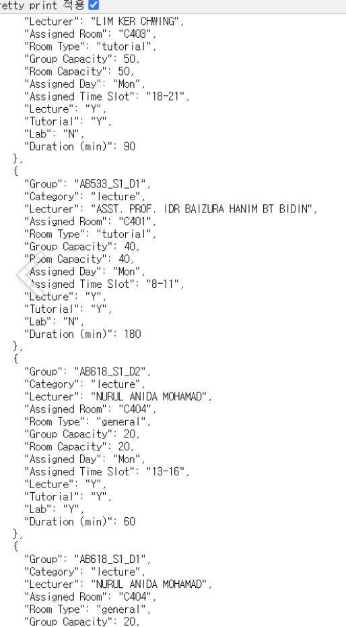
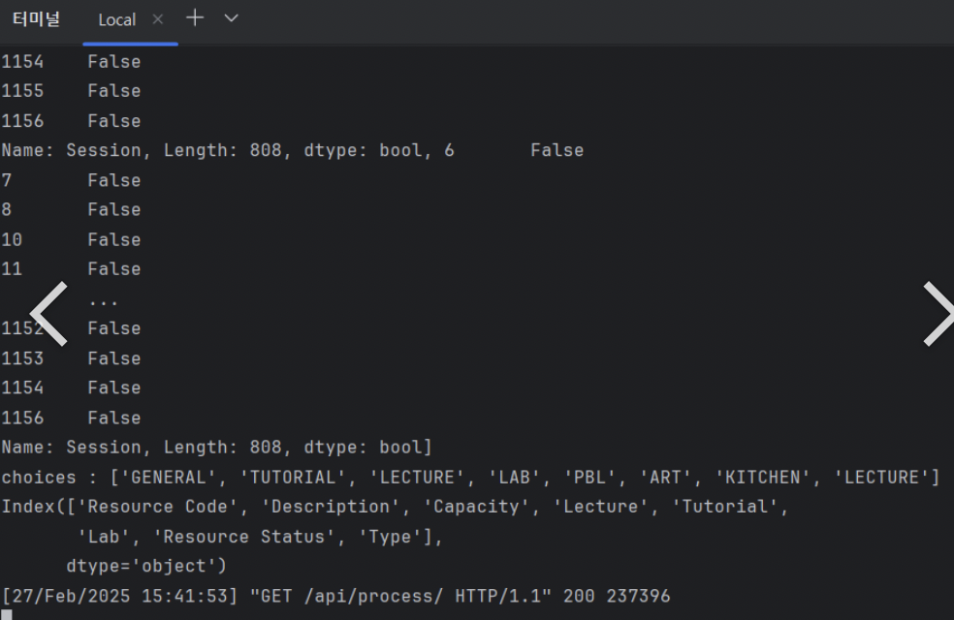
API connection

Slide 27
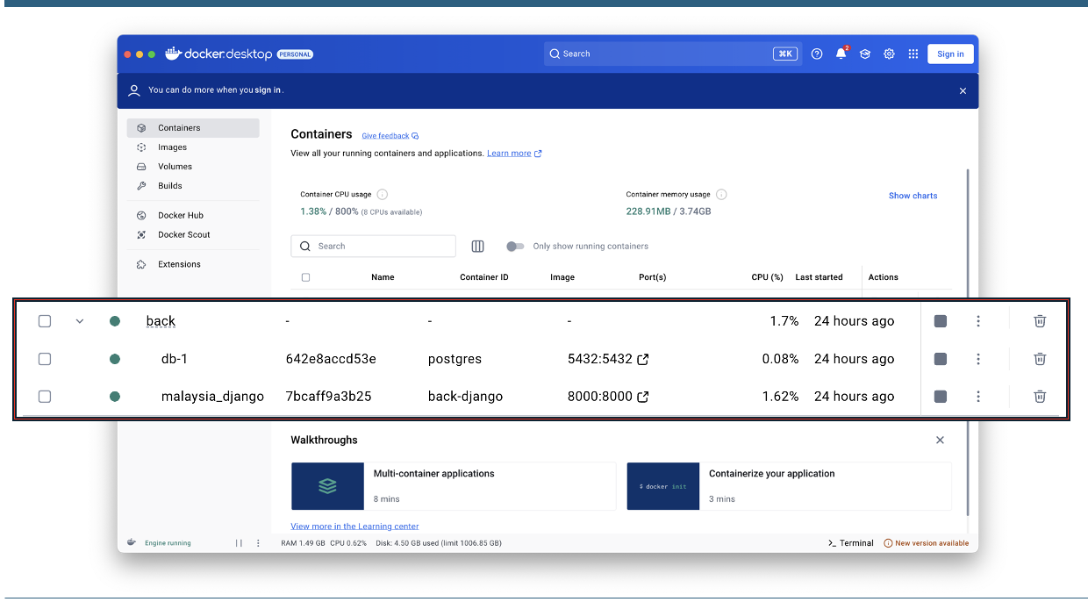
API connection

Slide 28
API connection

Slide 29
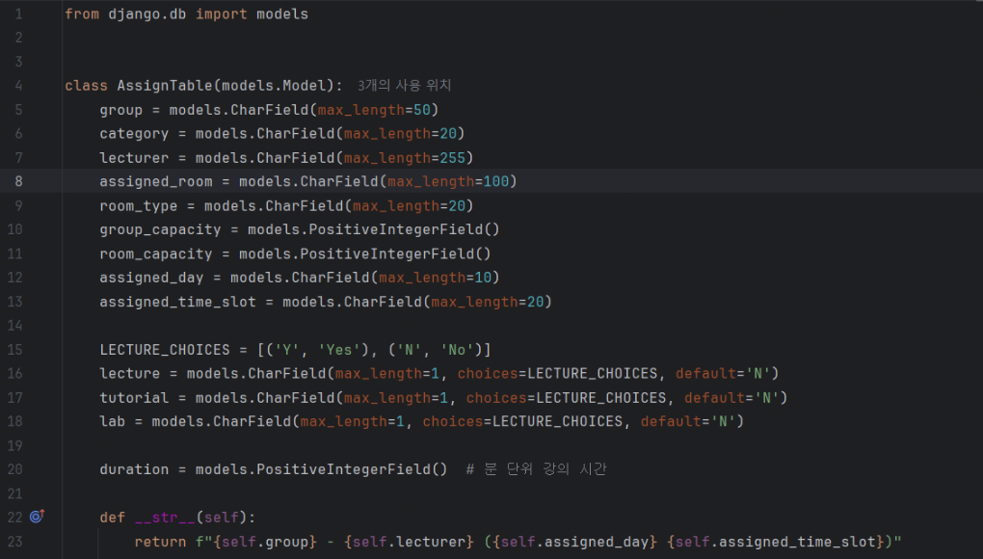
DB - Model

Slide 30
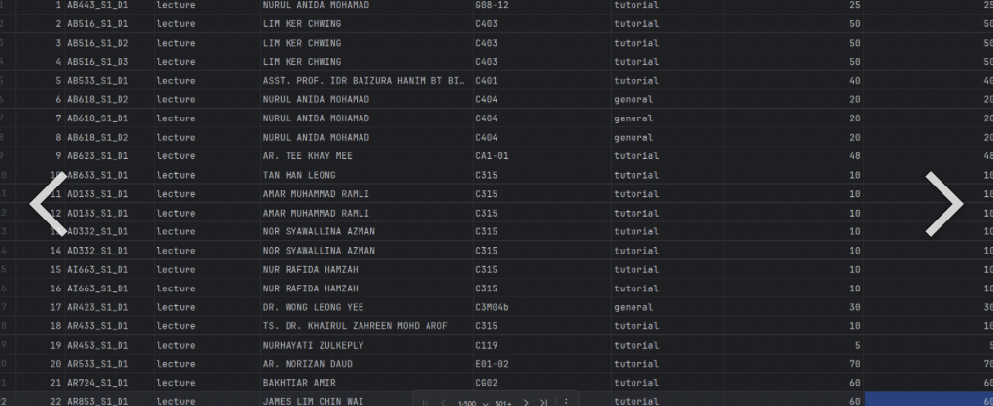
DB - Table

Slide 31
5. AI

Slide 32
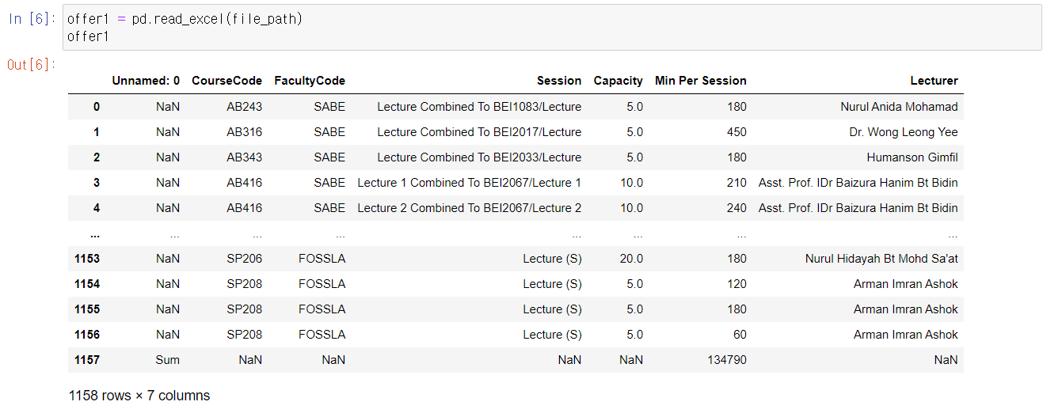
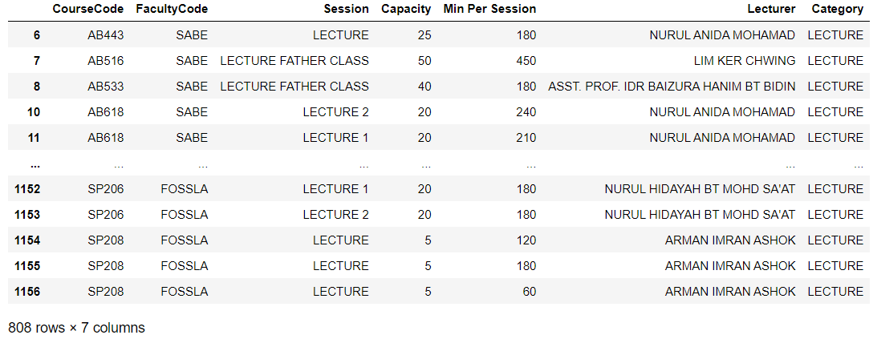
Offer data preprocessing

Slide 33
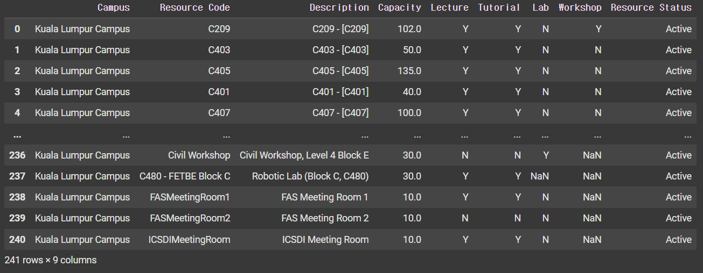
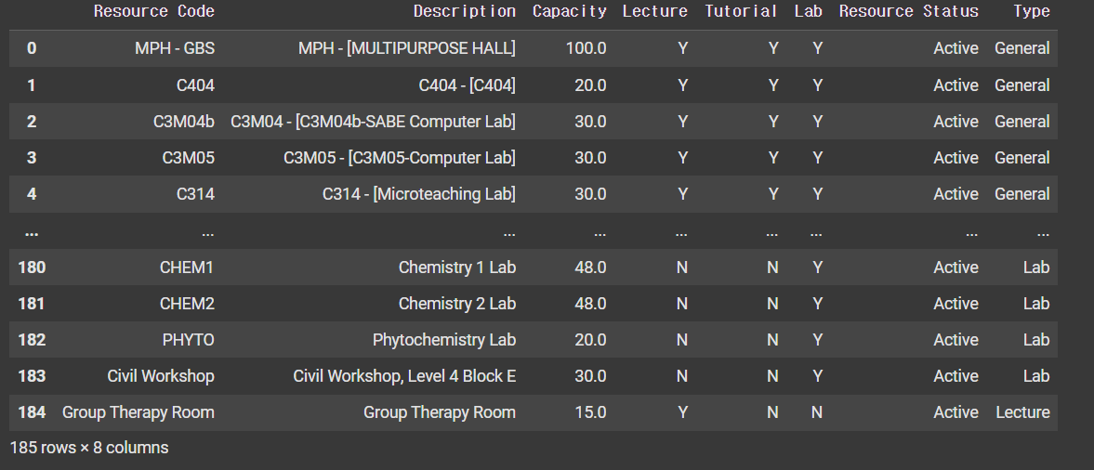
Resource data preprocessing

Slide 34
Conditions Used for Assignment Code Implementation
1. Match: match course category with room type. Exception: If Type = ETC, match with Category = TUTORIAL.
(All ETC rooms are available for tutorials.)
2. Split: If course duration exceeds 180 min, divide into ≤ 180 min sessions.
3. Time Slots: Classes only run at 8-11 AM, 1-4 PM, 6-9 PM.
4. Capacity: Room must have greater capacity than the course. If not, matching fails.
+
Hungarian Algorithm

Slide 35
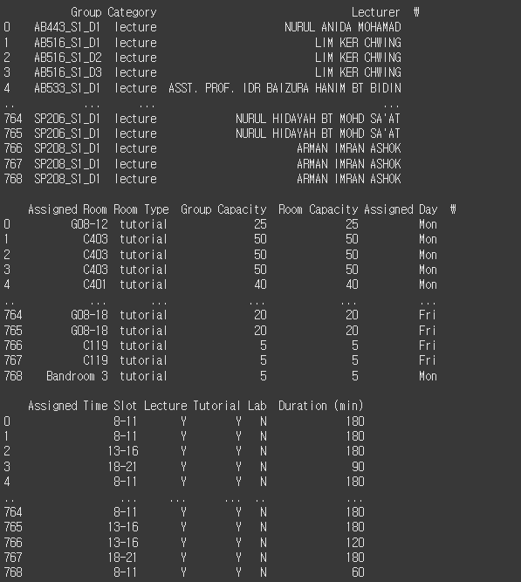
Final Assigned Data
> Prevent overlap of same time, room, and lecturer
Issue: Low assignment rate due to 2-hour break
> Code Modification for Optimization

Slide 36
Find optimal algorithms
Data Integrity Assurance: Error Segregation, Class Consolidation, Session-based Category Assignment
Try and errors, for example: genetic or greedy algorithms
Resolved lecture segmentation errors with the Hungarian algorithm and hourly granularity, boosting resource allocation from 0.95% to 39%.

Slide 37
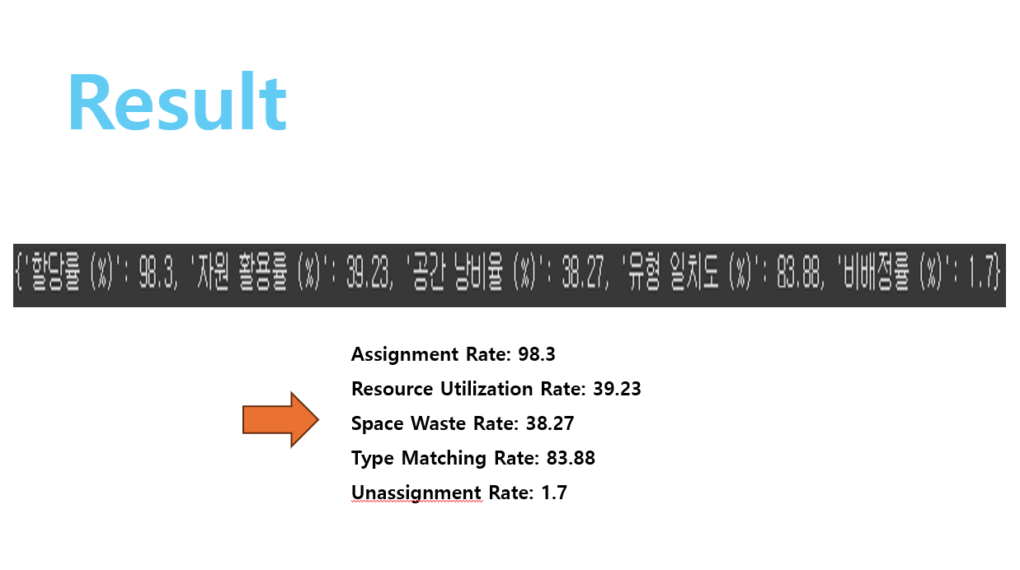
Result

Slide 38
6. Conclusion

Slide 39
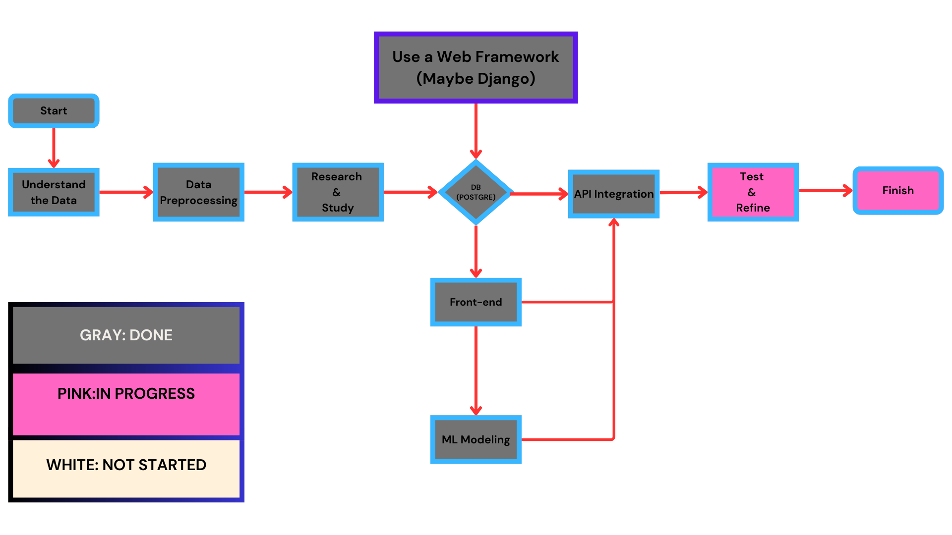

Slide 40
Thank you!

